Slide 1
Water pollution

Slide 2
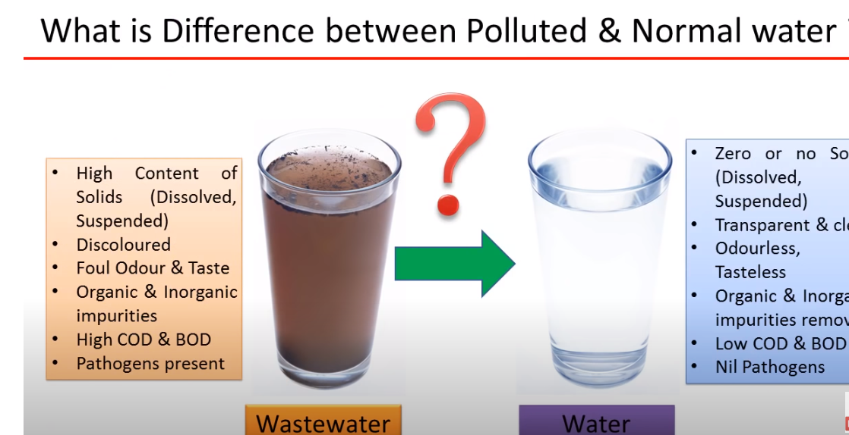

Slide 3
Types Of Pollutants
Pollutants enter water environments from two main types of sources.
Point sources
A point source is a single, identifiable source of pollution, such as a pipe or a drain. Industrial wastes are commonly discharged to rivers and the sea in this way.
EPA regulates high-risk point source waste discharges through the works approval and licensing system, and associated compliance and enforcement activities.
Non-point sources
Non-point sources of pollution are often termed ‘diffuse’ pollution. They refer to inputs and impacts which occur over a wide area and are not easily attributed to a single source. They are often associated with particular land uses, as opposed to individual point source discharges.

Slide 4
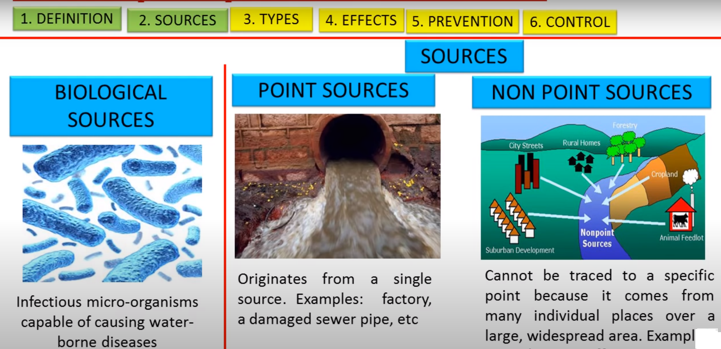

Slide 5
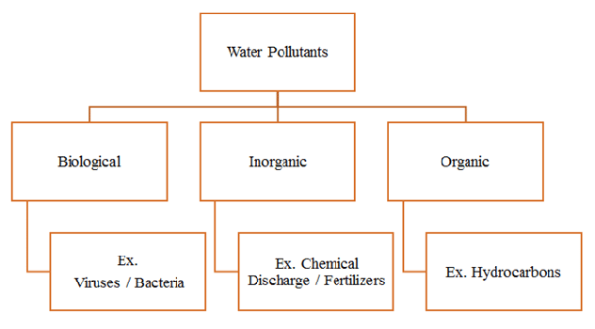
Types of water pollutants

Slide 6
Biological Pollutants
Pathogens are disease-causing microorganisms, e.g., viruses, bacteria, parasitic worms, and protozoa, which cause a variety of intestinal diseases such as dysentery, typhoid fever, hepatitis, and cholera.
Pathogens enter water primarily from human and animal fecal waste due to inadequate sewage treatment.

Slide 7
Chemical Pollutants
Chemical pollution from agriculture, industry, cities, and mining threatens global water quality. Air pollutants from these activities can also enter bodies of water (and become water pollutants) through dry deposition, precipitation, and runoff.
Any natural water contains dissolved chemicals, some of which are important human nutrients while others can be harmful to human health. The concentration of a water pollutant is commonly given in very small units such as parts per million (ppm) or even parts per billion (ppb).
Total dissolved solids (TDS) represent the total amount of dissolved material in water.
Inorganic pollutants include nutrients like nitrate (NO₃⁻) and phosphate (PO₄³⁻), heavy metals, chloride (Cl⁻), and radioactive isotopes released from mining or nuclear accidents (such as cesium, iodine, uranium, and radon gas).

Slide 8
Organic Pollutant/Bio Chemical Oxygen Demand
Too much decaying organic matter in water is a pollutant because it removes oxygen from water, which can kill fish, shellfish, and aquatic insects. The amount of oxygen used by aerobic (in the presence of oxygen) bacterial decomposition of organic matter is called biochemical oxygen demand (BOD). The major source of dead organic matter in many natural waters is sewage; grass and leaves are smaller sources.
Oxygen-demanding waste is an extremely important pollutant to ecosystems. Most surface water in contact with the atmosphere has a small amount of dissolved oxygen, which is needed by aquatic organisms for cellular respiration. Decomposers, such as bacteria and fungi, also conduct cellular respiration and consume oxygen as they break down dead organic matter according to the following reaction:

Slide 9
Organic Pollutant/Eutrophication
Eutrophication is the process in which a water body becomes overly enriched with nutrients, leading to plentiful growth of simple plant life. The excessive growth (or bloom) of algae and plankton in a water body are indicators of this process. Eutrophication is considered to be a serious environmental concern since it often results in the deterioration of water quality and the depletion of dissolved oxygen in water bodies. Eutrophic waters can eventually become “dead zones” that are incapable of supporting life.

Slide 10
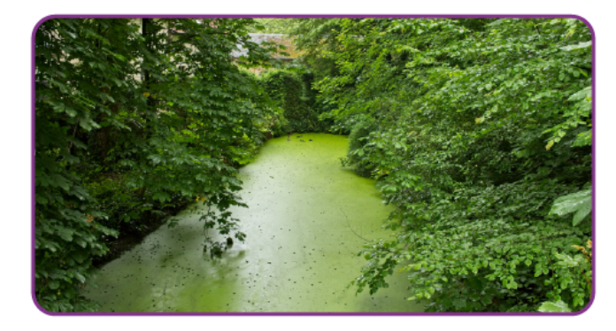

Slide 11
Causes of Eutrophication
The availability of nutrients such as nitrogen and phosphorus limits the growth of plant life in an ecosystem. When water bodies are overly enriched with these nutrients, the growth of algae, plankton, and other simple plant life is favoured over the growth of more complex plant life.
How do Water Bodies Become Overly Enriched?
Some other phosphorus-rich sources that enrich water bodies with the nutrient include:
Fertilizers
Untreated sewage
Detergents containing phosphorus
Industrial discharge of waste.

Slide 12
Biomagnification
Biomagnification can be defined as the rise or increase in the contaminated substances caused by the intoxicating environment.
The contaminants might be heavy metals such as mercury, arsenic, and pesticides such as polychlorinated biphenyls and DDT.
These substances are taken up by the organisms through the food they consume. When the organisms in the higher food chain feed on the organisms in the lower food chain containing these toxins, these toxins get accumulated in the higher organisms.

Slide 13
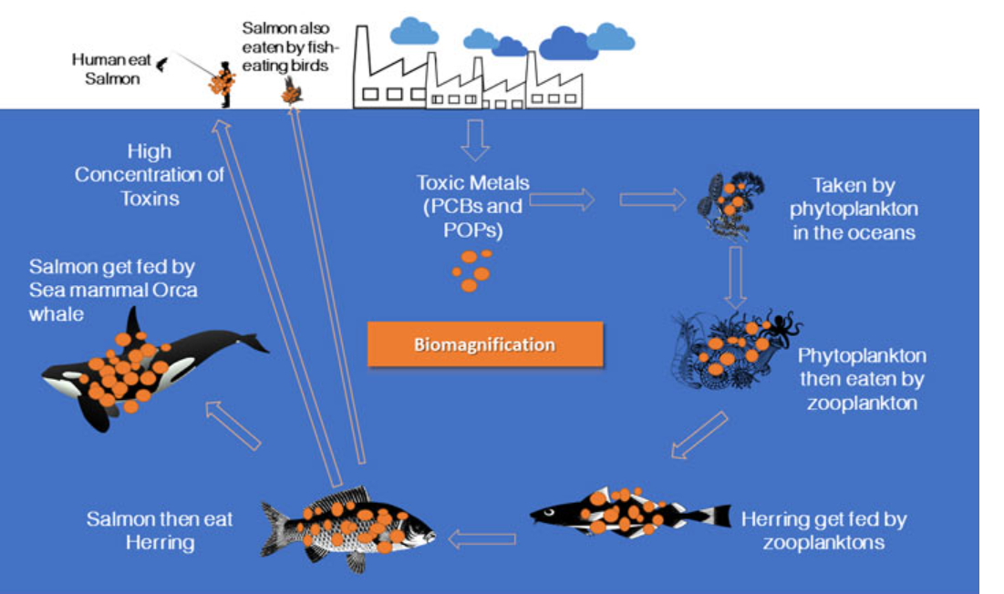

Slide 14
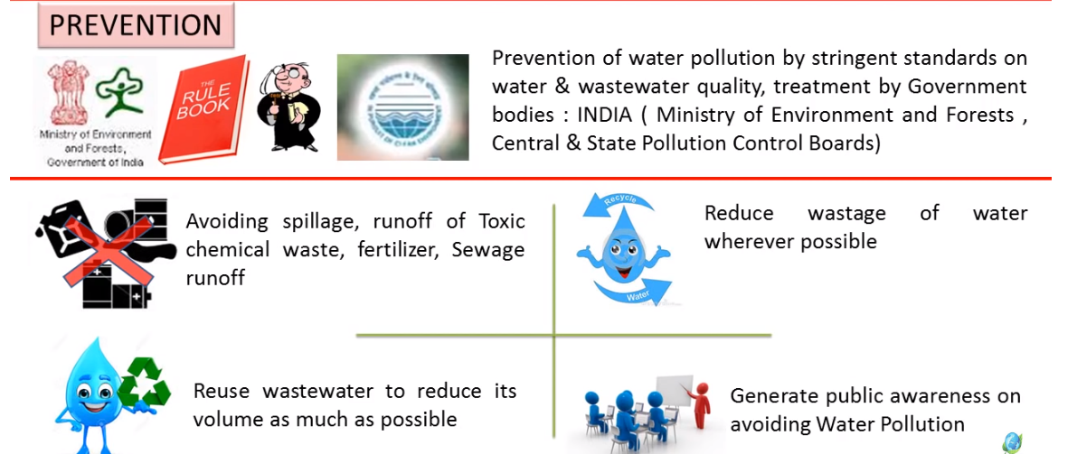
Prevention

Slide 15
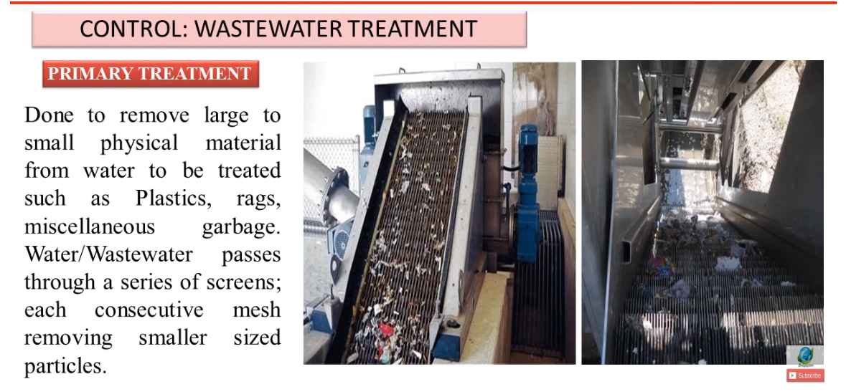
Control

Slide 16
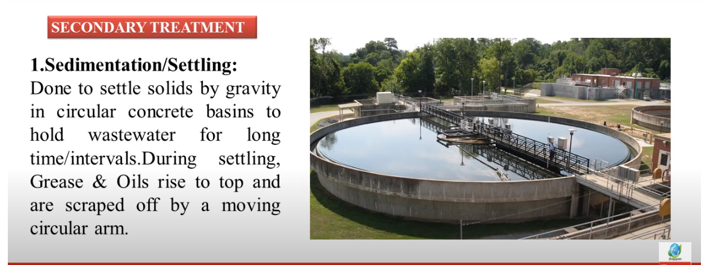

Slide 17
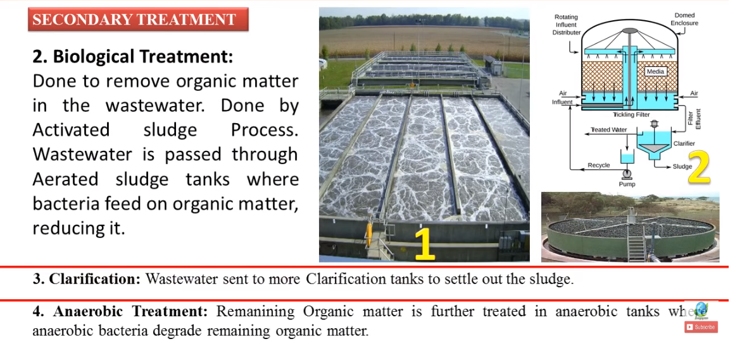

Slide 18
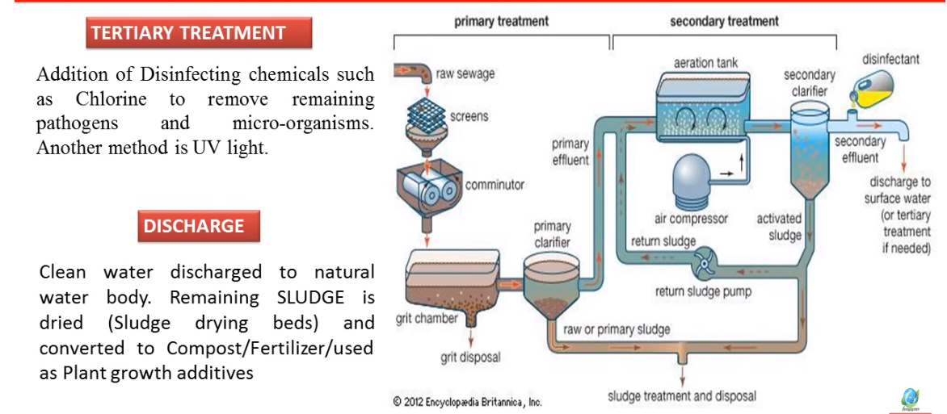

Slide 19
Composition of soil, classification nd effect of pollutantsnd controll
marine: Causes, effect and control, coastal zone treatment
Thermal

Slide 20
Soil Pollution
Soil pollution refers to the contamination of soil with anomalous concentrations of toxic substances.
It is a serious environmental concern since it harbours many health hazards. For example, exposure to soil containing high concentrations of benzene increases the risk of contracting leukaemia.

Slide 21
Composition of Soil
The soil is composed of different components: 5% organic matter, 45% minerals, 20-30% different gases and 20-30% water. Therefore, the soil is known as a heterogeneous body. Given below is the composition of soil in detail:
Organic Matter
Organic substance is found in very small amounts in the soil. Plants and animals are the main sources of organic matter. Depending upon the decomposition stage, the organic matter is of the following three types:
Completely decomposed organic matter
Partially decomposed organic matter
Undecomposed organic matter

Slide 22
Minerals
Minerals are an important element of the soil. These are solid components composed of atoms. These occur naturally and have a fixed chemical composition.
Gaseous Components
The air-filled pores of the soil contain the gaseous components. Nitrogen and oxygen present in the pores is generally the atmospheric air fixed by the microorganisms. However, the composition of carbon dioxide is higher due to the gas produced by microorganisms present in the soil.
Water
The soil dissolves the minerals and nutrients in the water and transports it to different parts of the plants. These are essential for the growth and development of the plant.

Slide 23
What are the Pollutants that Contaminate Soil?
Some of the most hazardous soil pollutants are xenobiotics – substances that are not naturally found in nature and are synthesized by human beings.
The term ‘xenobiotic’ has Greek roots – ‘Xenos’ (foreigner), and ‘Bios’ (life). Several xenobiotics are known to be carcinogens.

Slide 24
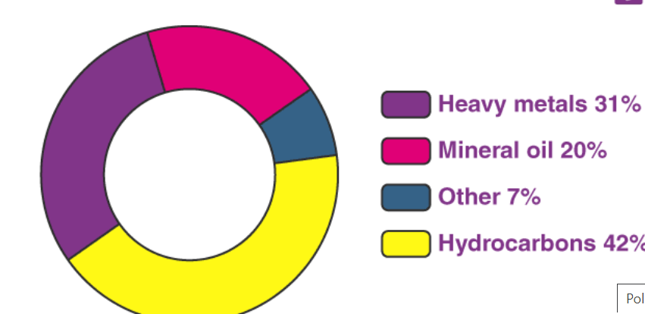
What are the Pollutants that Contaminate Soil?

Slide 25
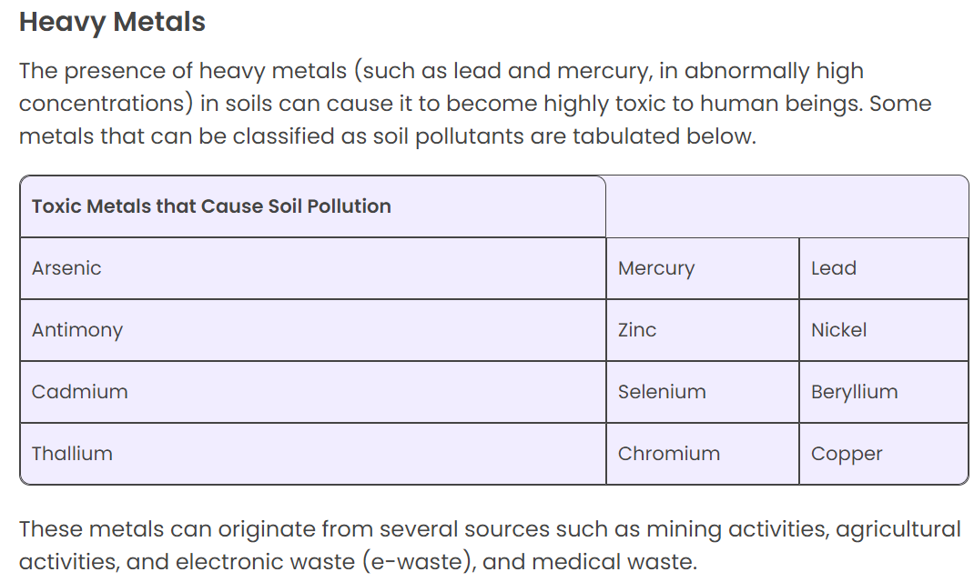

Slide 26
Polycyclic Aromatic Hydrocarbons
Polycyclic aromatic hydrocarbons (often abbreviated to PAHs) are organic compounds that
Common examples of PAHs include naphthalene, anthracene, and phenalene. Exposure to polycyclic aromatic hydrocarbons has been linked to several forms of cancer. These organic compounds can also cause cardiovascular diseases in humans.
Soil pollution due to PAHs can be sourced to coke (coal) processing, vehicle emissions, cigarette smoke, and the extraction of shale oil.

Slide 27
Pesticides
Pesticides are substances (or mixtures of substances) that are used to kill or inhibit the growth of pests. Common types of pesticides used in agriculture include
Herbicides – used to kill/control weeds and other unwanted plants.
Insecticides – used to kill insects.
Fungicides – used to kill parasitic fungi or inhibit their growth.
However, the unintentional diffusion of pesticides into the environment (commonly known as ‘pesticide drift’) poses a variety of environmental concerns such as water pollution and soil pollution.

Slide 28
What are the Processes that Cause Soil Pollution?
Soil pollution can be broadly classified into two categories –
Naturally caused soil pollution
Anthropogenic soil pollution (caused by human activity)
Natural Pollution of Soil
In some extremely rare processes, some pollutants are naturally accumulated in soils. This can occur due to the differential deposition of soil by the atmosphere. Another manner in which this type of soil pollution can occur is via the transportation of soil pollutants with precipitation water.
An example of natural soil pollution is the accumulation of compounds containing the perchlorate anion (ClO₄–) in some dry, arid ecosystems. It is important to note that some contaminants can be naturally produced in the soil under the effect of certain environmental conditions. For example, perchlorates can be formed in soils containing chlorine and certain metals during a thunderstorm.

Slide 29
Anthropogenic soil pollution (caused by human activity)
Agriculture (excessive/improper use of pesticides)
Excessive industrial activity
Poor management or inefficient disposal of waste

Slide 30
What are the Negative Consequences of Soil Pollution?
Effects on Human Beings
The short term effects of human exposure to polluted soil include
Headaches, nausea, and vomiting.
Coughing, pain in the chest, and wheezing.
Irritation of the skin and the eyes.
Fatigue and weakness.
A variety of long-term ailments have been linked to soil pollution. Some such diseases are listed below.
Exposure to high levels of lead can result in permanent damage to the nervous system. Children are particularly vulnerable to lead.
Depression of the CNS (Central Nervous System).
Damage to vital organs such as the kidney and the liver.
Higher risk of developing cancer.

Slide 31
Effects on Plants and Animals
Since soil pollution is often accompanied by a decrease in the availability of nutrients, plant life ceases to thrive in such soils. Soils contaminated with inorganic aluminium can prove toxic to plants. Also, this type of pollution often increases the salinity of the soil, making it inhospitable for the growth of plant life.
Plants that are grown in polluted soil may accumulate high concentrations of soil pollutants through a process known as bioaccumulation. When these plants are consumed by herbivores, all the accumulated pollutants are passed up the food chain. This can result in the loss/extinction of many desirable animal species. Also, these pollutants can eventually make their way to the top of the food chain and manifest as diseases in human beings.

Slide 32
Effects on the Ecosystem
It can also contribute to acid rain (by releasing huge quantities of ammonia into the atmosphere).
Acidic soils are inhospitable to several microorganisms that improve soil texture and help in the decomposition of organic matter. Thus, the negative effects of soil pollution also impact soil quality and texture.
Crop yield is greatly affected by this form of pollution.

Slide 33
How can Soil Pollution be Controlled?
Several technologies have been developed to tackle soil remediation. Some important strategies followed for the decontamination of polluted soil are listed below.
Excavation and subsequent transportation of polluted soils to remote, uninhabited locations.
Extraction of pollutants via thermal remediation – the temperature is raised in order to force the contaminants into the vapour phase, after which they can be collected through vapour extraction.
Bioremediation or phytoremediation involves the use of microorganisms and plants for the decontamination of soil.
Mycoremediation involves the use of fungi for the accumulation of heavy metal contaminants.

